Slide 1

DHL Odoo Shipping
Integration
Jeet Jethwa-91900104013
Under guidance of Prof. Yatri Davda

Slide 2
outline
Abstract
Used Technology
List of Functionalities
Background Work
Database design and diagram
UML diagrams
References

Slide 3
Abstract
DHL Express Shipping Integration offers reliable shipping solutions. Odoo DHL shipping integration becomes absolutely crucial for you. This integration will helps to connect with a DHL shipping carrier with Odoo. You can perform various operations like get Live shipping rate, Generate Shipping labels, Track Shipment, You can cancel the shipments too.Perform these all various operations without accessing DHL Dashboard with the help of DHL API. To use this functionality, You have to provide DHL live credentials. All these features make your work easier. You can able to proceed all operations crucially with API data and API authorisation parameters Regarding to security of this process.

Slide 4
Used Technology:
PyCharm : PyCharm is an integrated development environment used for programming in Python.
Python Programing Language : The primary programming language of Odoo is Python.
XML : Odoo views are dynamically created from XML codes. Data of Odoo are stored as objects and XML description is used to expose these objects to the user interface.
Odoo : Odoo is a suite of business management software tools including, for example, CRM, e-commerce, billing, accounting, warehouse, project management, and inventory management.
Postman : Postman is an API platform for building and using APIs.
Postgre sql : PostgreSQL is used as the primary data store or data warehouse for many web, mobile, geospatial, and analytics applications.

Slide 5
Functionalities :
As per requirement, Use shipping method in test and live environment.
Get live rate.
Generate shipping labels based on order information.
Live track shipment according to shipment tracking number.
Multiple Label supported in one shipment.

Slide 6
Background Work :
Packages and pallets, big and small, we can offer you an instant quote for your shipping needs both domestically and internationally.
The retailer you purchased from may have used this service to send your package. Contact this division if your shipment was sent using DHL eCommerce or DHL Parcel.

Slide 7
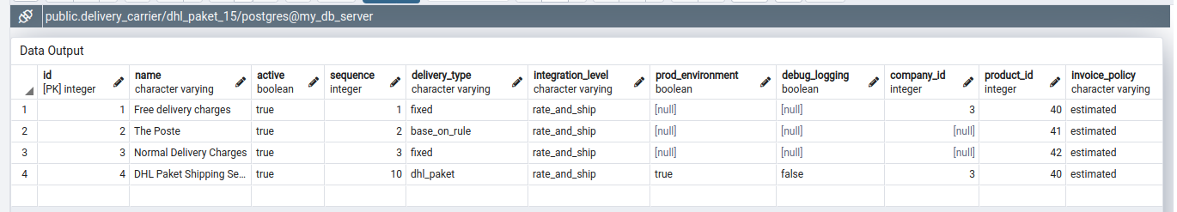
Database design and diagram

Slide 8
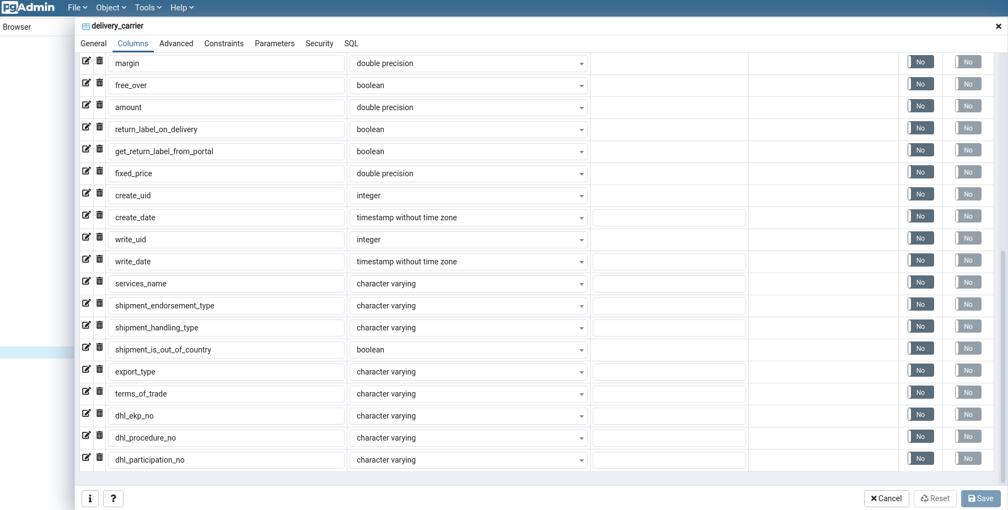

Database design and diagram

Slide 9
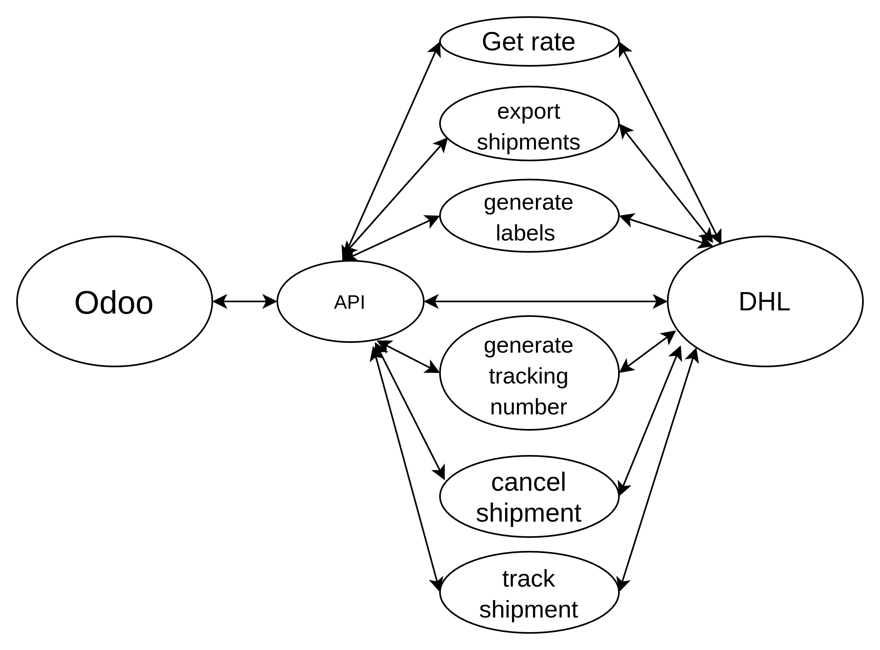
UML diagrams

Slide 10
References
[1] Aaker, D. A. (2001), Strategic market management. John Wiley & Sons, Inc. CourierWestford, United States of America.
[2] Ahmed, P.K &Rafiq, M. (2003), Internal market issues and challenges, European Journal ofMarketing, Vol. 37 No. 9, pp. 1177-1186.
[3] Bennett, R & Thiele, S.R. (2004), Customer satisfaction should not be the only goal, Journalof Services Marketing, Vol. 18 No. 7, pp. 514-523.

Slide 11
𝒯𝒽𝒶𝓃𝓀 𝒴𝑜𝓊
Presented by: Jeet Jethwa
ERP Developer - VrajaTechnologies
Guided by:
Prof. Yatri Davda

